Slide 1
JavaScript Lab 3
Intro to JavaScript for Beginners
Notes:
Hello everyone and welcome to this lesson, where we are going to do a quick overview of JavaScript

Slide 2
1 Objects
JavaScript for React

Slide 3
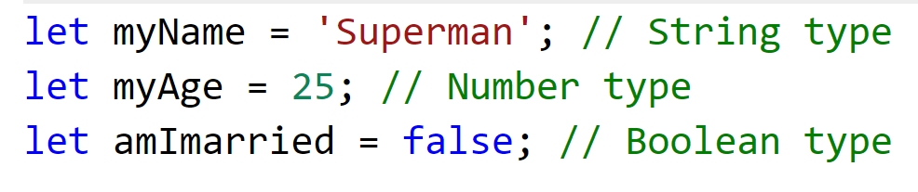
So far, we have seen how we can store single values into variables ……

Slide 4
Let’s say we want to store info about employees
The employee details that we are interested in are:
Name
Age
MaritalStatus
Salary
How do we store this info logically ?

Slide 5
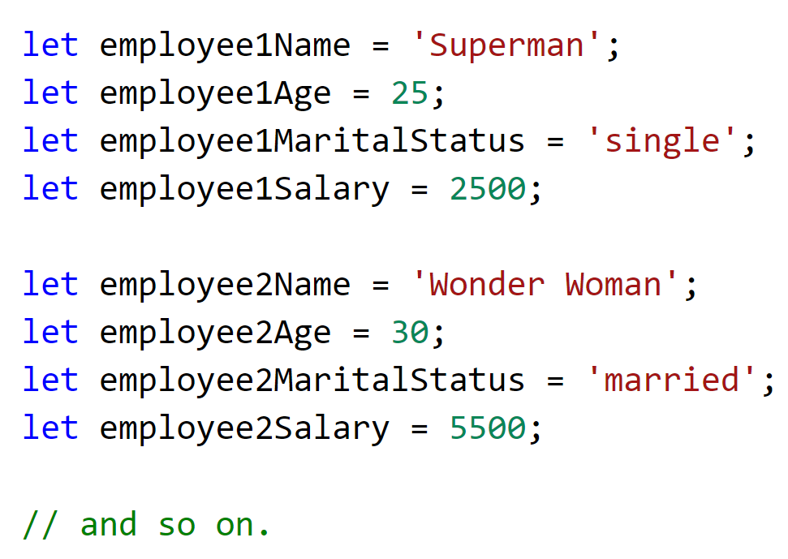
This works, but how do we clearly group the variables related to a single employee ?
It would be nice if we could have a single variable that could somehow store all related employee data !

Slide 6
Objects
An object is a complex data type
Allows us to group together related basic (primitive) data types
Object is a collection of properties
Each property consists of a key-value pair
The key of a property is usually a string, while the value can be anything
For e.g. string, number, boolean, function, or even another object

Slide 7
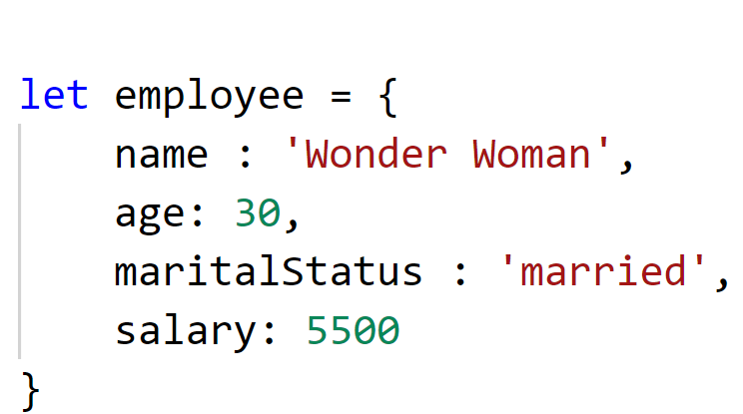
Property
key
value

Slide 8
2 Arrays
JavaScript for React

Slide 9
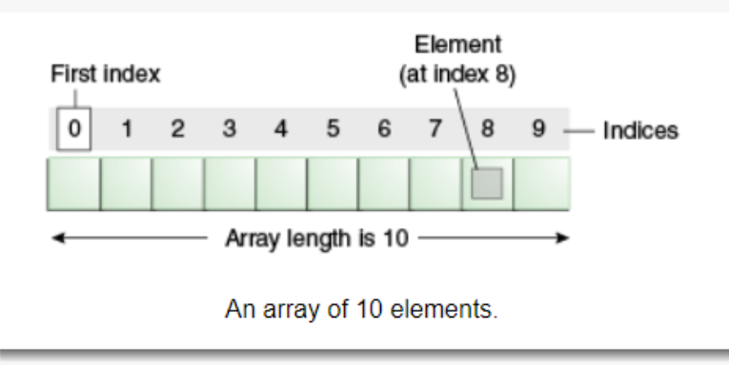
Using arrays

Slide 10
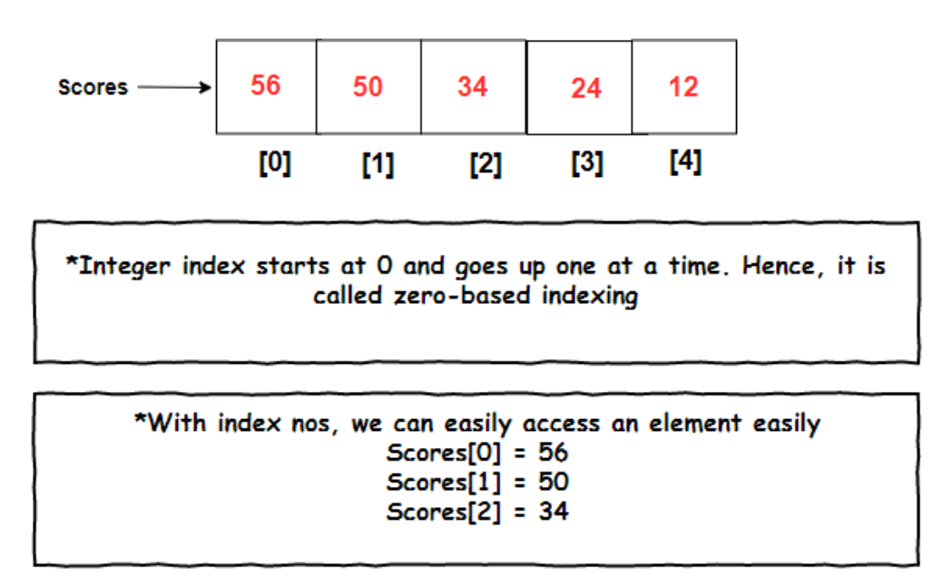
Using arrays

Slide 11
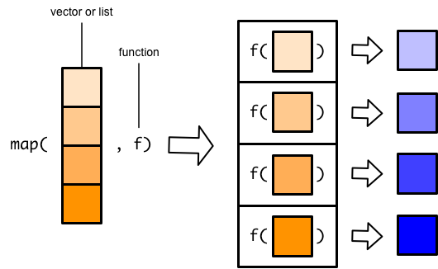
Higher-order function: Map

Slide 12
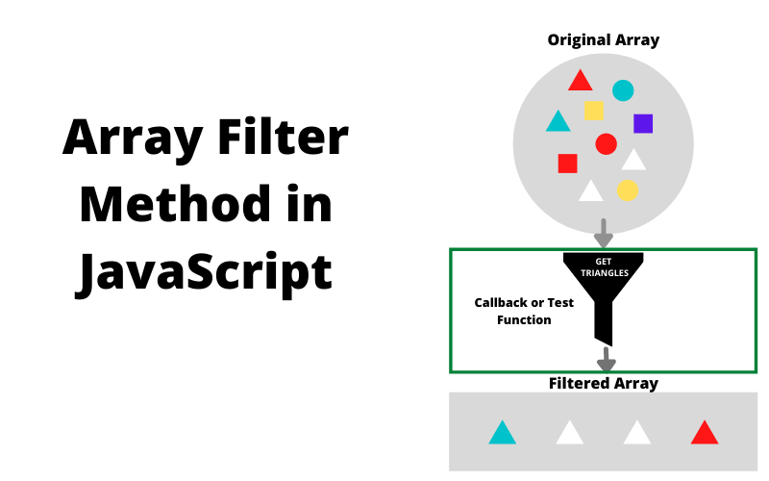
Higher-order function: Filter

Slide 13
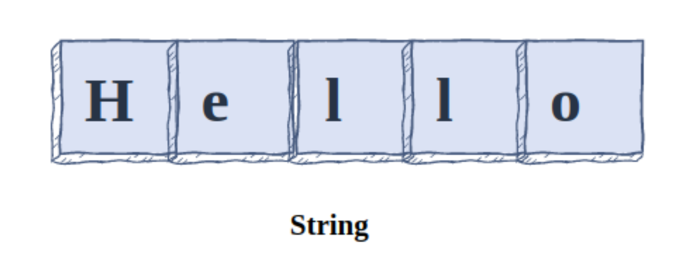
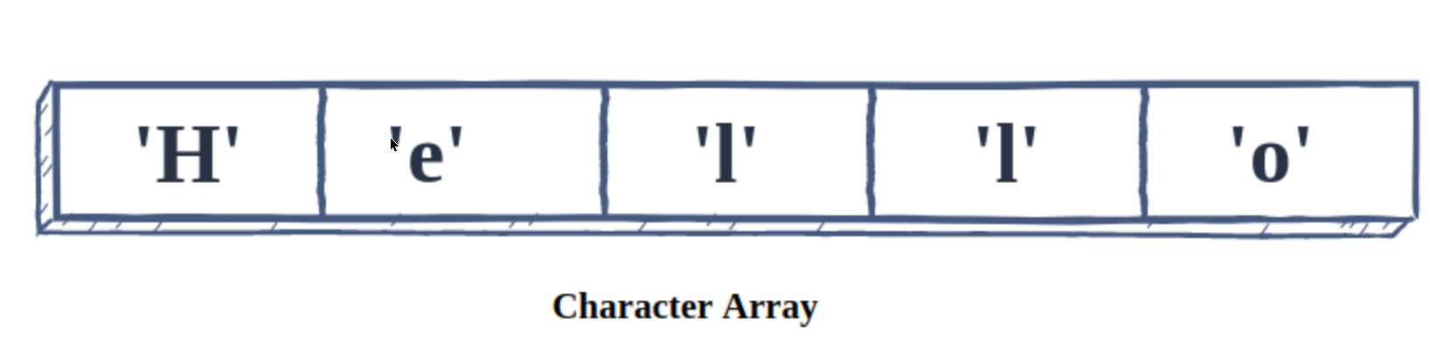
String is an array of characters
0
1
2
3
4

